Slide 1



Digital
Games
Game Design - 201
Tue 2-4:45pm C-356
Prof. A McClure

Slide 2
Last Week’s Homework
Download and install Game Maker
(via Steam or Yoyogames.com)
Read Ch2 of Trigger Happy
Play: Spacewar! - http://spacewar.overstigma.com
Pong
Adventure
http://www.web-adventures.org/cgi-bin/webfrotz?s=Adventure

Slide 3
Last Week’s Homework (continued)
Reading and Game Response 1 (RGR1): Write a thoughtful one to two page reflection after you have played the games and read the material. Topics to consider: What are some new things you learned? What are some lessons we can take away from the early days of the video game? Are these games still compelling?
link - http://bit.ly/1fTm5vJ

Slide 4
//insert discussion
Notes:
what did we think of the reading?
how do we feel about adventure? spacewar? pong?

Slide 5
This Week

Slide 6
Avideo
Game Design Exercise

Slide 7
A-video
games
without video

Slide 8



Slide 9
digital: yes, video: no

Slide 10
how can you represent the core being of the game?

Slide 11
DIG.IT.AL
(of signals or data) expressed as series of the digits 0 and 1, typically represented by values of a physical quantity such as voltage or magnetic polarization.

Slide 12
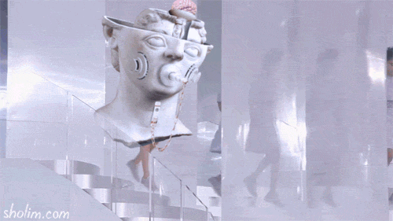
mechanization of imagination

Slide 13
Design a digital game based on a popular video game… without video...
something that would be impossible as a strictly analog game

Slide 14
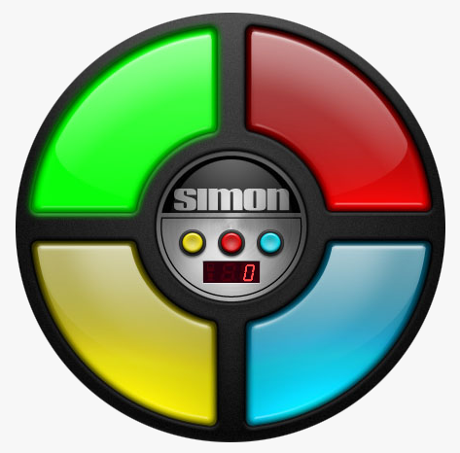

Notes:
not asking you to combine a game, but what if call of duty played more like simon

Slide 15
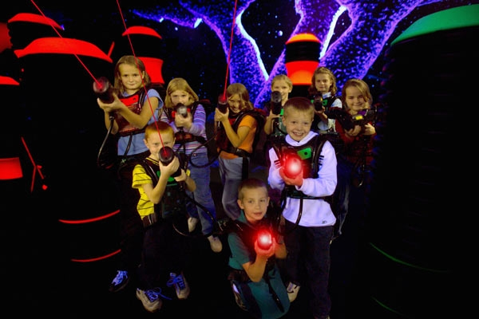

Slide 16
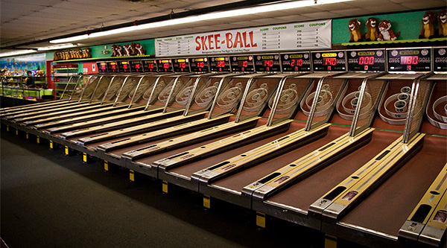

Slide 17
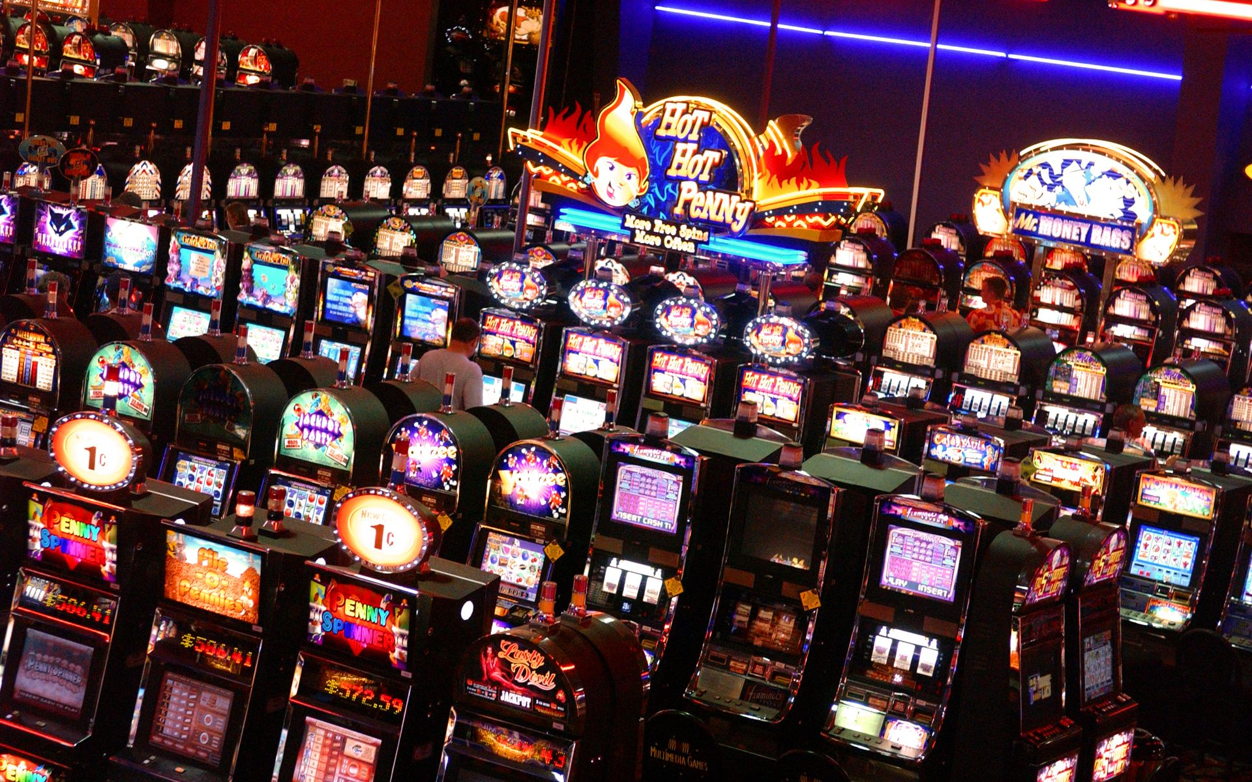

Slide 18
6 groups

Slide 19
Group 1 - Legend of Zelda: Ocarina of Time
Group 2 - Pac-Man
Group 3 - The Sims
Group 4 - Portal
Group 5 - Sonic the Hedgehog 2
Group 6 - Fruit Ninja

Slide 20
30 MINUTES

Slide 21

HALT!
let’s share

Slide 22
Group 1 - Counter-Strike
Group 2 - Super Smash Brothers
Group 3 - World of Warcraft
Group 4 - Mario Kart 64
Group 5 - Mortal Kombat II
Group 6 - Second Life

Slide 23
10 MINUTES

Slide 24
reHALT!
let’s share

Slide 25
Discussion Time
Most successful adaptation?
Least successful?
Why?

Slide 26
HOMEWORK

Slide 27
Download and install Game Maker if you haven’t already…
Game Maker Studio Lite (Windows)
Game Maker for Mac Lite (OS X)
Start exploring and experimenting in the application.

Slide 28
HOMEWORK PLAY
HOMEWORK RGR2 (500 word minimum)
Cookie Clicker by Orteil (Julien Thiennot)
play for at least 4 hours (including idle time)
Read Numbers Getting Bigger by Alexander King
Write a thoughtful response to your experience with Cookie Clicker and other incremental/idle games.
Some things to think about…
Should games be fun?
Would this work as an analog game?
What are some more well known games that use similar design strategies?
How can this inform your own design practice?
Are clicking games evil?

Slide 29
Digital
Games
Game Design - 201
Tue 4-4:45pm C-356
Prof. A McClure

Slide 30
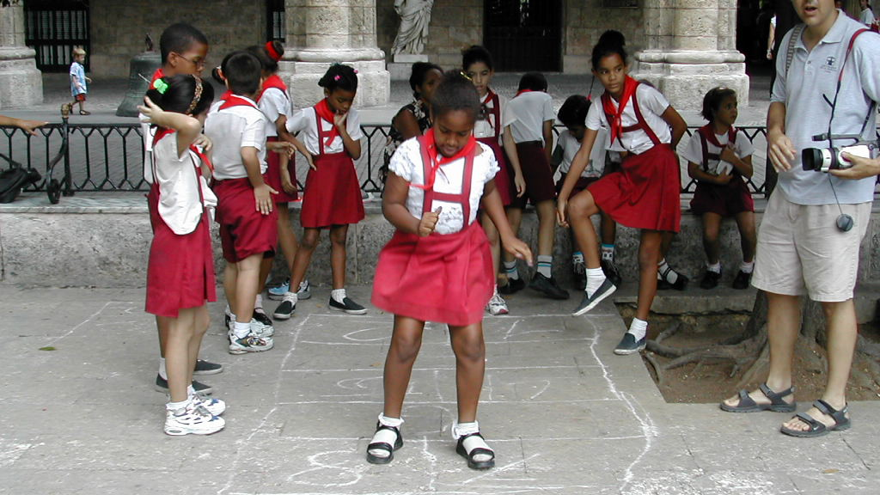

Slide 31
Hopscotch
“Hopscotch is a children's game that can be played with several players or alone. Hopscotch is a popular playground game in which players toss a small object into numbered spaces of a pattern of rectangles outlined on the ground and then hop or jump through the spaces to retrieve the object.”

Slide 32
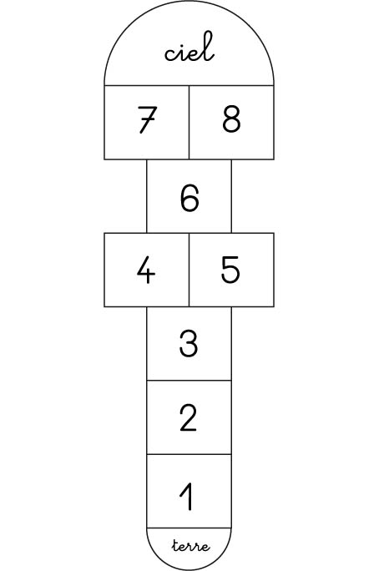
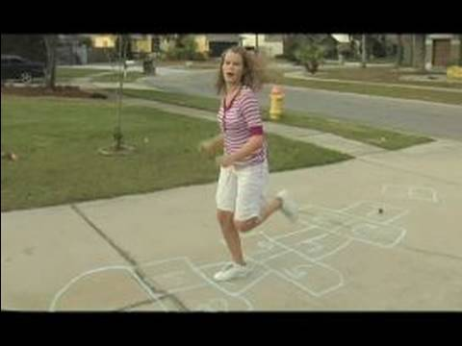

Slide 33
Anachronistic Chalk Games
a·nach·ro·nism
əˈnakrəˌnizəm/
noun
a thing belonging or appropriate to a period other than that in which it exists, especially a thing that is conspicuously old-fashioned.
Notes:
define anachronism

Slide 34
Hoppy Bird?
Katahopi Damacy?
Chalk of Duty: Black Hops?
Mirror’s Edge: Vertical Hopscotch?
Candy Crush: Hop Edition?
Notes:
were trying to reproduce the core mechanics of digital games

Slide 35
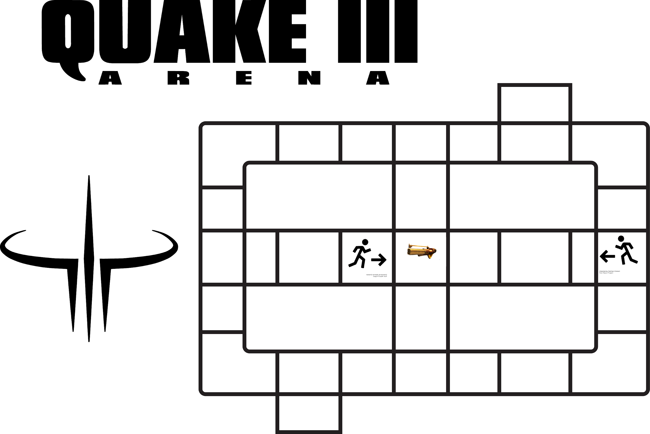
Notes:
turn based. players get three moves and one action. rocket launcher has 2 tile blast radius

Slide 36
ZE PLAN [begin ~10:30am]
Assemble 4 Random Teams - A, B, C, D
5 minutes to discuss and choose games in groups
Teams will pick 3 games
We will go outside
30 minutes to create each game
5-10 minutes to play each game

